Slide 1
Bank Deposit insurance in CEE
Yuki.Irie
Oleksandr Gerasymov

Slide 2
Introduction
On June 22nd 2015, the “Five Presidents’ Report” of the European Commission decided to initiate a European Deposit Insurance Scheme (EDIS)
No EU-wide solution before DGS for guaranteeing European depositors when banks across the Union found themselves in trouble.
EDIS will be introduced on a step-by-step basis starting in 2017, finalizing in 2024.
This installation of EDIS, officially proposed on the 24th of November by the European Commission, should strengthen confidence in the banking industry in Europe and take further steps in completing the European monetary union.
Notes:
as the finalization of the third pillar of the European banking union. EDIS will be put in place to guarantee depositors throughout the EU a 100,000 euro security on every deposit, a measure now put in place by deposit guarantee schemes (DGS) on which Sia Partners already reported in the beginning of 2015.

Slide 3
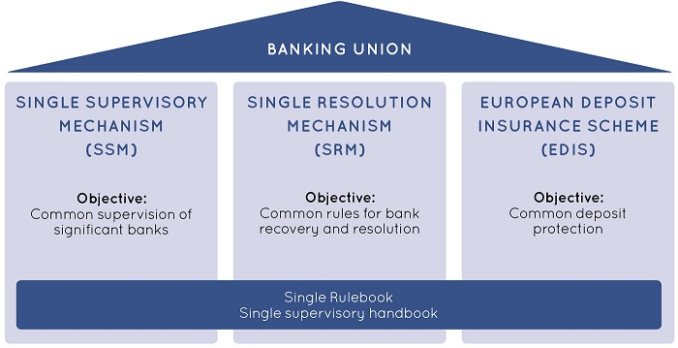
The last pillar of the European banking union

Slide 4
Towards more guarantees for European deposit holders

Slide 5
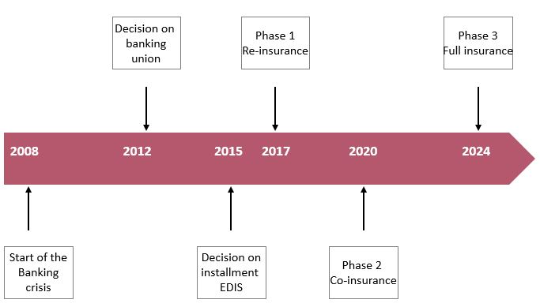
Timeline and next steps of the European deposit insurance scheme
Notes:
Phase1: Re-insurance: in case of bank crisis, depositors are able to get up to 100,000 euros per bank deposit account.
Second phase will be introduced in 2020. In case of bankruptcy, EDIS will contribute to the repayment of depositors starting from the first euro of loss. This system of co-insurance should start diminishing the importance of the national deposit guarantee schemes and the give more strength to EDIS.
Finally, phase 3 will be put into action in 2024. at the moment EDIS will entirely take over the roles of national deposit guarantee schemes and will insure depositors for the full 100%. = Importance of EDIS increases and also gives safety and security to deposit holders.
By the end of 2024, this system aims to cover 0.80% of all deposits in the Euro-zone with a total of over 50 billion euros.

Slide 6
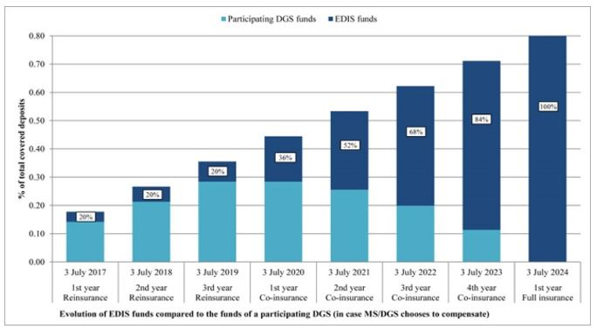
Timeline and next steps of the European deposit insurance scheme

Slide 7
Pitfalls influencing the long- and short-term implementation of ED
Germany is not in favor of saving banks in other countries with money contributed from their own banks.
Questions about moral hazard among the banks
The transition period from re-insurance to full insurance

Slide 8
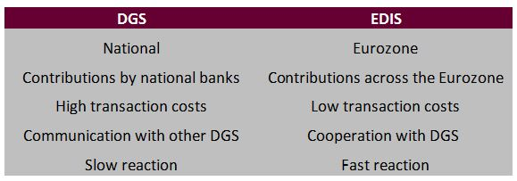
How will EDIS give Europeans safer deposits?
First of all, is there any a need for a installment of EDIS?
Instead of DGS, EDIS gives more Stability for both short and long term
Notes:
In case of bank failure today, DGS would take action and make sure that deposits worth 100,000 euros would be insured so that depositors are not carrying the mistakes made by the management off the banks. The problem with the DGS is that large local shocks cannot be fully supported. This implies that a failure of the banking system affecting multiple banks could be fatal for the present guarantee schemes.

Slide 9
Is the work to complete the banking union finished?
Overall it is definitely a step in the right direction to install EDIS by a gradual step-by-step process and to communicate a strong message to the European deposit holders. This process will allow the European Commission to deal with possible pitfalls that will occur down the road, optimize the EDIS construction, and prepare for different scenarios.

Slide 10
SOURCES
The Banking Union
http://en.finance.sia-partners.com/20131106/the-european-banking-union
http://en.finance.sia-partners.com/20131120/the-european-banking-union-22
European deposit insurance scheme
http://www.euractiv.com/sections/euro-finance/commission-aims-having-full-european-deposit-insurance-scheme-2024- 319792
http://www.ft.com/inl/cms/s/0/ba8a7064-77f5-11e5-933d-efcdc3c11c89.html#axzz3xbndHNBN http://www.reuters.com/article/eurozone-greece-reform-banks-idUSL8N0Z70OB20150621
http://www.nytimes.com/2015/11/25/business/eu-proposes-a-common-deposit-insurance-program-for- eurozone.html?_r=0

