Slide 1
FinTech in the CEE
Victor Lannois Weronika Tołściuk

Slide 2
Agenda
FinTech - what is it?
FinTech Sector in the CEE
Regulations in the CEE a) regulations in the EU b) level of implementation
Case studies
References
Notes:
Main point: But it is important to ensure the fast speed of implementation to necessary reduction of uncertainty linked to the law environment. Both PSD II and GDPR ensure higher standards and many simplifications for digital economy, so countries that are further in the process of implementation (especially Estonia, Poland and Slovakia) have the significant advantage.
FinTech in General: https://home.kpmg.com/xx/en/home/insights/2017/07/the-pulse-of-fintech-q1-17-global-analysis-of-funding-in-the-fintech-sector.html Fintech sector: http://www.techbullion.com/10-popular-fintech-sectors/

Slide 3
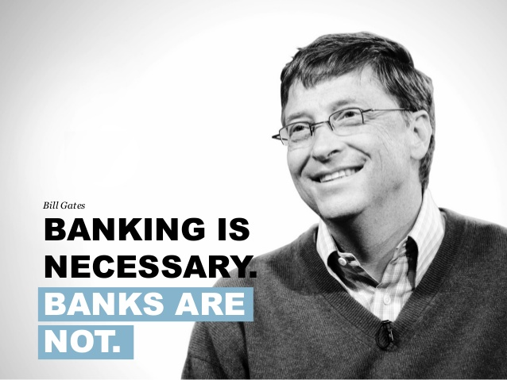
Definition: “fintech is a new financial industry that applies technology to improve financial activities."
Key sectors: Banking-, insurance- and finance industry
In Q1’17, global investment in fintech companies hit high of 3,2 Billion Dollar
Best known for mobile payment applications such as PayPal
Well spread over the StartUp-scene
Notes:
First Point:Since the end of the first decade of the 21st century, the term has expanded to include any technological innovation in the financial sector, including innovations in financial literacy and education, retail banking, investment and even crypto-currencies like
bitcoin.
Second Point: Areas of application numbers, hedging, investment, provision, financing or consulting
Fourth Point: Counterpart to classic bank
Quote: Bill Gates said it. Back in 1994. And 28 years later, it’s set to become reality.
References:
Schueffel, Patrick (2017-03-09). "Taming the Beast: A Scientific Definition of Fintech". Journal of Innovation Management. 4 (4): 32–54. ISSN 2183-0606.
https://assets.kpmg.com/content/dam/kpmg/xx/pdf/2017/04/pulse-of-fintech-q1.pdf
https://marcabraham.com/2017/05/22/how-psd2-is-set-to-change-banking-up-as-we-know-it/

Slide 4
FinTech sector in the CEE
Smart Finance Management
Insurtech
Internet & Mobile Banking
Peer-to-Peer Lending
Crowdfunding
Notes:
“quote” http://irishtechnews.ie/why-bill-gates-and-mark-zuckerberg-are-investing-in-fintech-for-the-poor/
“In the next 15 years, digital banking will give the poor more control over their assets and help them transform their lives.”
https://marcabraham.files.wordpress.com/2017/05/bill-gates.jpg

Slide 5
The estimated size of the FinTech market
2.2 bn euro
2016
Source: FinTech in the CEE region - a report by Deloitte

Slide 6
A Bulgarian fund supporting the most promising entrepreneurs and digital startups in Southern and Eastern Europe. LAUNCHub invests in micro-seed and seed stages, tickets ranging from €30,000 to €200,000.
Since its inception in 2012, LAUNCHub has invested in 60 startups from 10 countries in the South-East Europe region, including Bulgaria, Romania, Macedonia, Croatia, Greece, Slovenia, Ukraine, Austria and Switzerland.

Slide 7
Regulations in the CEE (Regulations in the EU)
Till now, the most important regulations concerning FinTech sector and future directions of European authorities were concluded in the Discussion Paper on EBA’s approach to financial technology (FinTech).
These regulations are the following:
· the Payment Accounts Directive (PAD);
· the Electronic Money Directive (EMD);
· the Payment Services Directives 1 and 2 (PSD/PSD2)
and few more...
General Data Protection Regulation

Slide 8
Level of implementation
Chart 1. The level of implementation of Payment Services Directive II among CEE countries (EU Members States)
Countries, where public consultation has been already initiated
Countries, where public consultation has not been initiated yet

Slide 9
Charts 2. The level of implementation of General Data Protection Regulation among CEE countries (EU Member States)
Countries, where public consultation has been already initiated
Countries, where public consultation has not been initiated yet

Slide 10
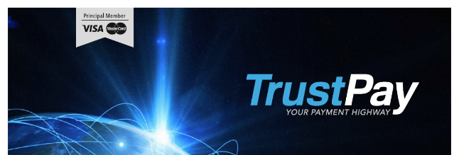
Case Study - TrustPay
Located in Bratislava, Slovakia
Founded 2009
One of the first FinTech companies providing secure e-commerce payments across EEA area
Membership with VISA Europe, MasterCard and UnionPay
Notes:
Info: https://www.trustpay.eu/about-us/history/
Picture:https://www.linkedin.com/company/trustpay

Slide 11
TrustPay - Services
Card Acquiring - Possibility to accept card payments from customers all over the world
TrustPay payment gateway is accessible for all merchants around the EEA
Corporate Account - Alternative to traditional bank accounts
Further Services such as prepaid cards, SEPA direct debit or instant bank transfers in the Czech Republic and Slovenia
Notes:
3. Benefiting from having own iban for EUR, USD and GDBdominated accounts
4.Fintech company which not only offers a save way to pay or revieve money all over europe and ecpecially in the CEE but offers alternatives to the classic banking

Slide 12
Case Study - mBank
Located in Warsaw, Poland
Founded 1986 (BRE), 2000 (mBank) - first e-bank in Poland
Sławomir Lachowski

Slide 13
mBank services
Solutions offered by mBank
Electronic banking system: Since June 2013 the bank has been serving its retail customers through New mBank, a redesigned electronic banking platform.
Mobile banking: In February 2014, the bank launched a new version of its mobile banking platform. The smartphone application gives access to bank accounts, cards, loans, deposits, insurance products, current share prices, currency exchange rates and investment portfolio
mBank will set up the “first” fund in Central and Eastern Europe that will specialise in developing and selling new technologies. Will provide €50 million in investment to start-ups

Slide 14
5. References
Schueffel, Patrick (2017-03-09). "Taming the Beast: A Scientific Definition of Fintech". Journal of Innovation Management. 4 (4): 32–54. ISSN 2183-0606.
https://assets.kpmg.com/content/dam/kpmg/xx/pdf/2017/04/pulse-of-fintech-q1.pdf
2. https://marcabraham.com/2017/05/22/how-psd2-is-set-to-change-banking-up-as-we-know-it/
3. https://www.launchub.vc/
4. https://www.trustpay.eu/about-us/history/
5. http://www.comarch.pl/
6. https://www.mbank.pl/indywidualny/

