Slide 1
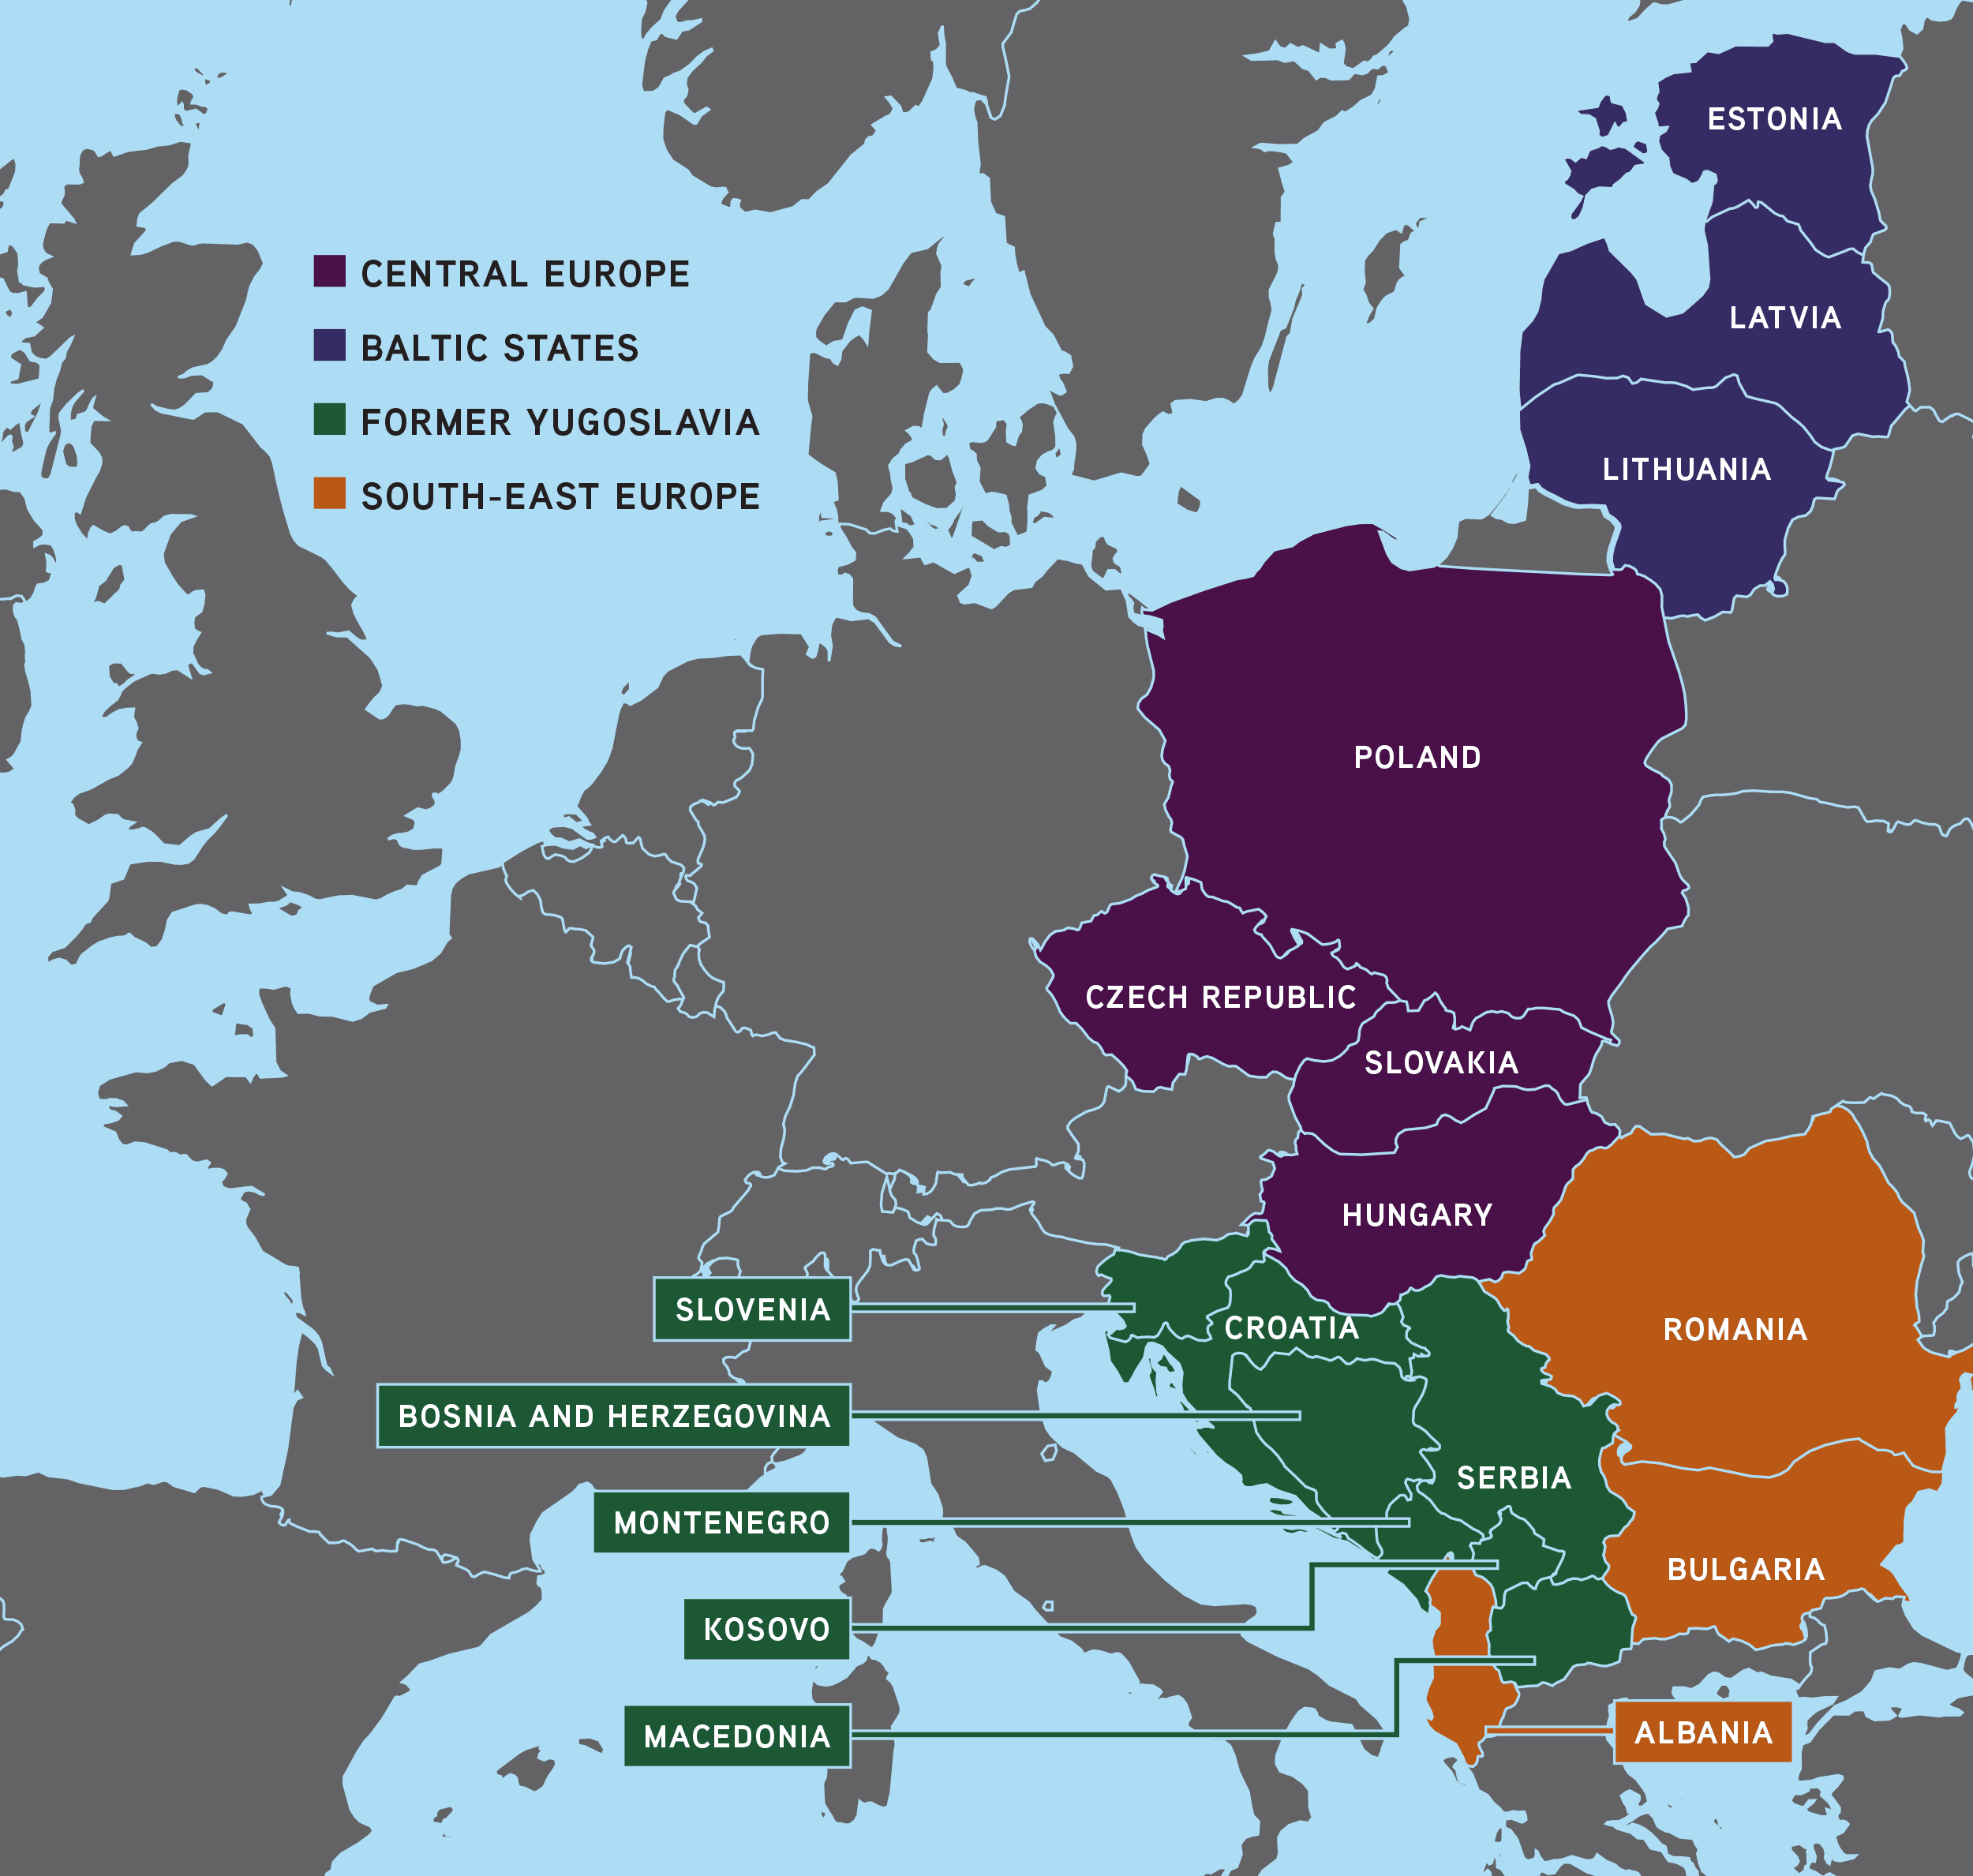
History of the region CEE

Slide 2
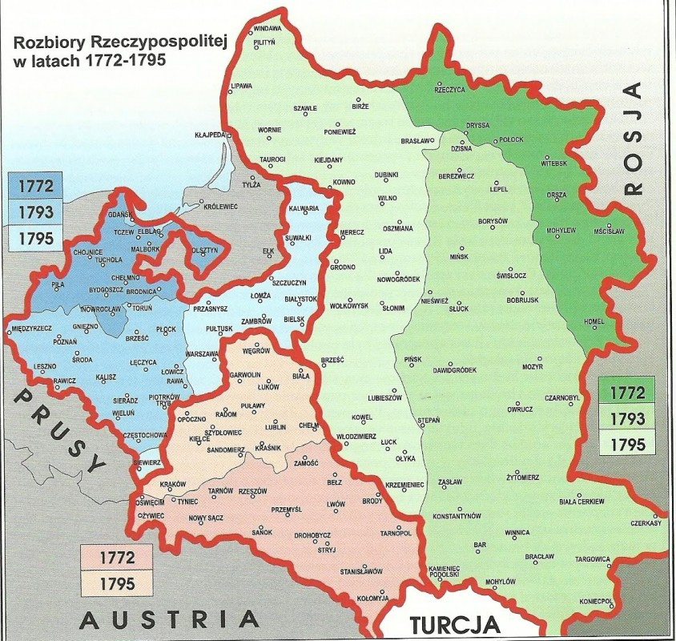
1795 – 1918
3 V 1791
Partitions of Poland
Phenomenon of polish spirit
,,Thank God for the war”

Slide 3
1918 – 1939
Borders – let’s cut the cake
3 in 1
28
Economic environment
Development
,,Worst place in the world”

Slide 4
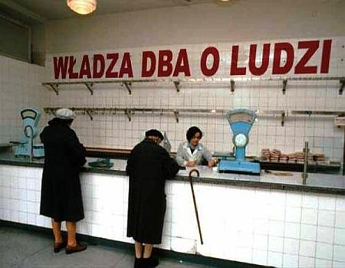
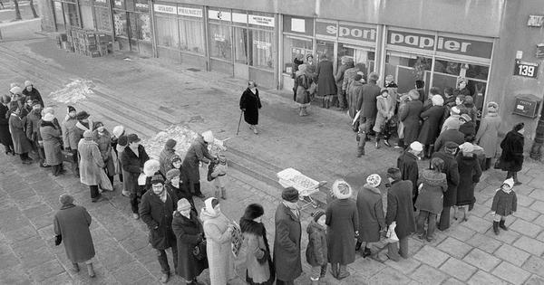
1939 – 1989
https://www.youtube.com/watch?v=Q88AkN1hNYM

Slide 5
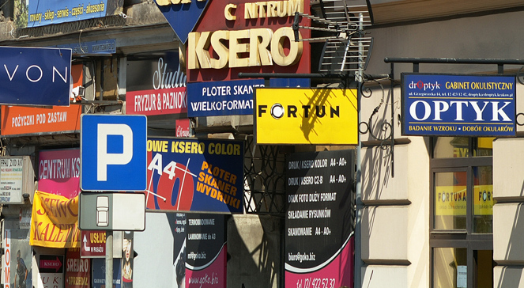
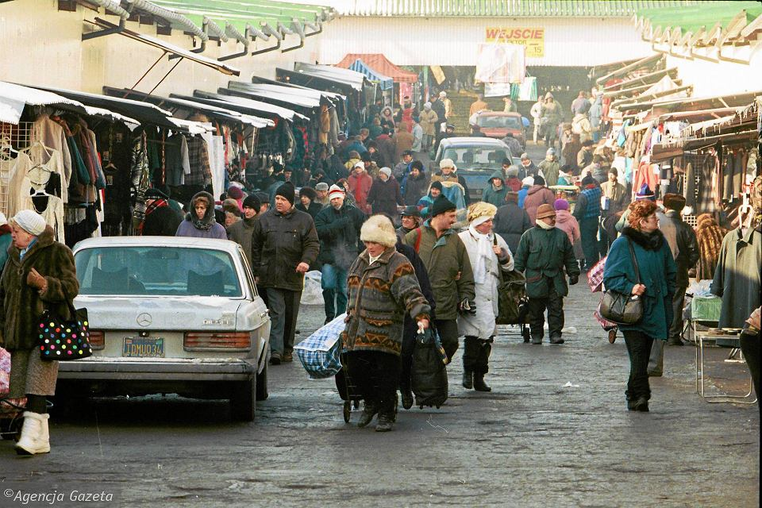
1989 – 2004
Pretending to be Western Europe
from centrally planned economy to capitalism
1999 – NATO
Winners and losers generation

Slide 6
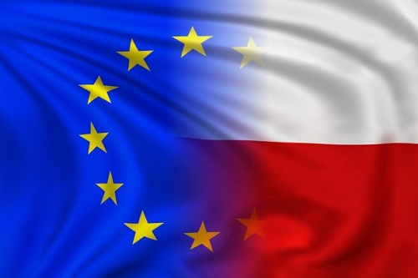
2004
https://www.youtube.com/watch?v=yfMAXukRpSU

Slide 7
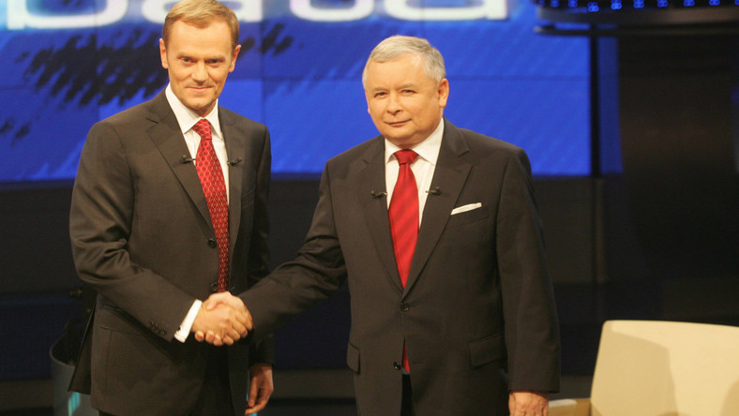
2004 - ?
Further growth vs. higher expectations
Dynamic environment
Two visions within Poland

Slide 8
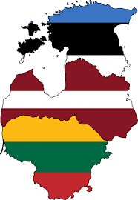
Baltic countries
These countries have been long dependent on neighboring countries, mainly Sweden, Denmark, Russia, Poland and the State of the Teutonic Order.
Before World War II these countries were independent and formed the Baltic Entente (The main objective of the agreement was joint action in foreign policy)
In 1940 they were annexed by the Soviet Union
In 1991 these countries were the first to declare independence
The Baltic States refused to join the Commonwealth of Independent States and are the only countries of the former Soviet Union in the European Union (from 2004) and NATO and the only countries of the former USSR belonging to the Western culture.
In these countries there is a large Russian national minority

Slide 9
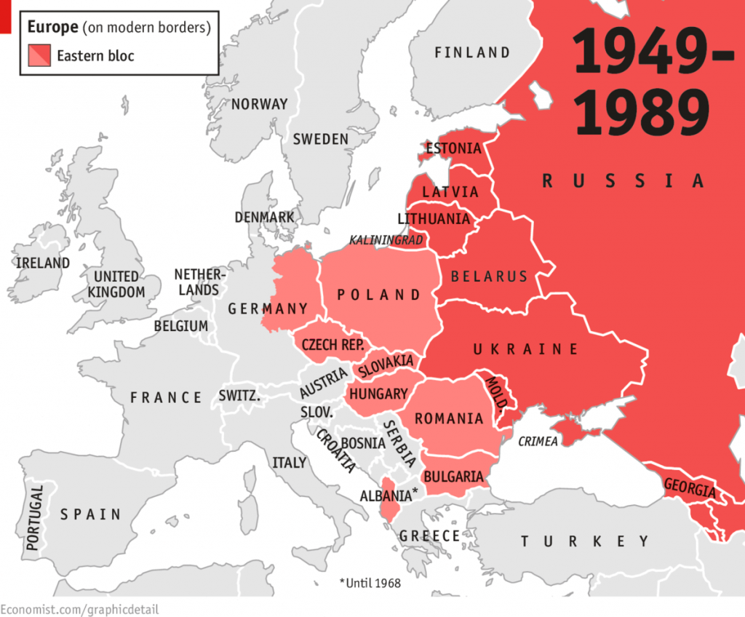

Slide 10
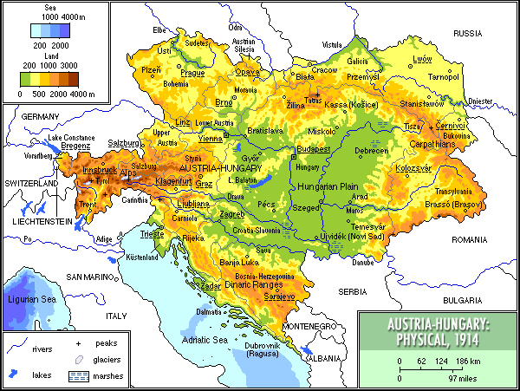
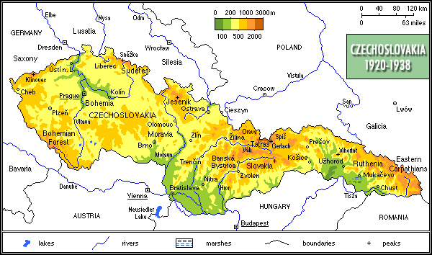
Czechoslovakia
Czechoslovakia existed from October 1918, when it declared its independence from the Austro-Hungarian Empire
From 1939 to 1945, following its forced division and partial incorporation into Nazi Germany, the state did not de facto exist but its government-in-exile continued to operate
From 1948 to 1990, Czechoslovakia was part of the Soviet bloc with a command economy. Its economic status was formalized in membership of Comecon from 1949 and its defense status in the Warsaw Pact of May 1955
In 1993, Czechoslovakia split into the two sovereign states of the Czech Republic and Slovakia

Slide 11
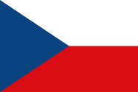
Czech Republic & Slovakia
The Czech Republic joined NATO in 1999 and the European Union (EU) in 2004; it is also a member of United Nations, OECD, OSCE, and Council of Europe and the Visegrád Group. The Czech Republic is a developed country with an advanced, high income economy and high living standards
Slovakia joined the European Union and NATO in 2004 and the Eurozone in 2009. Slovakia is also a member of the Schengen Area, United Nations, OECD, OSCE, Council of Europe and Visegrád Group. The Slovak economy is one of the fastest growing economies in Europe and 3rd fastest in eurozone

Slide 12
Hungary
In 1918 the Austrian-Hungarian Monarchy broke up, the first government was established and the country became the Republic of Hungary.
Hungary formally entered World War II as an Axis Power on 26 June 1941. Despite some early successes, the Hungarian government began seeking a secret peace pact with the Allies.
Germans then overran Hungary near the end of World War II and deposed the government to their nationalist allies. Hundreds of thousands died during the war or were deported to German concentration camps.
After the Germans were beaten by the Allies, Soviets took over the country, drove out the Germans, and stayed for 44 years.
In 1956 the people tried to force the leadership to stop this domination, and dictatorship by the soviets, but the attempt was unsuccessful
The soviet domination lasted until 1989, when Hungary finally became an independent democracy.
In 1999 Hungary joined NATO, and in 2004 became a member of the European Union.

Slide 13
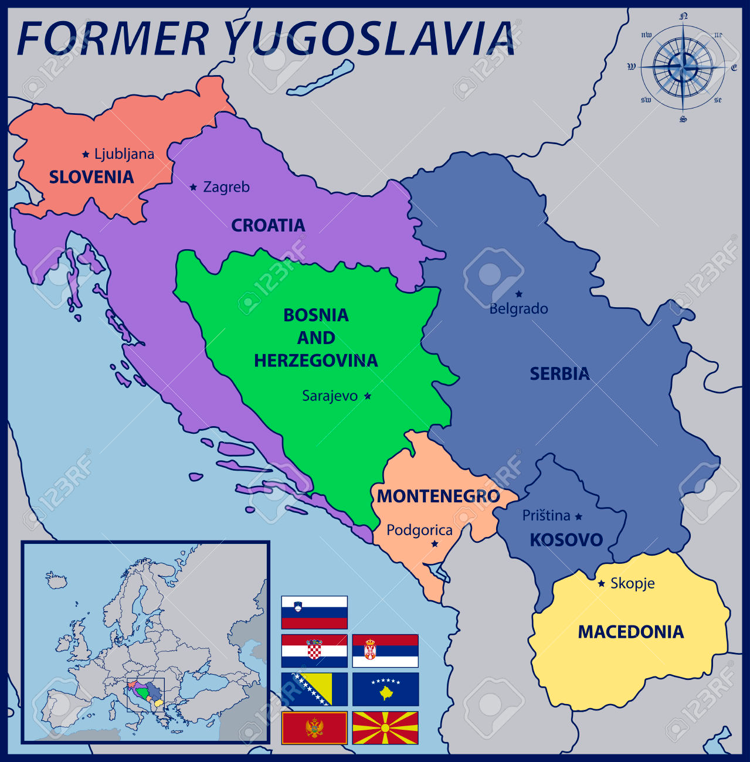
Yugoslavia
Yugoslavia came into existence after World War I in 1918 under the name of the Kingdom of Serbs, Croats and Slovenes by the merger of the provisional State of Slovenes, Croats and Serbs
It was invaded by the Axis powers on 6 April 1941
Between 1941 and 1945 the Yugoslav state was under occupation
Yugoslavia was renamed the Federal People's Republic of Yugoslavia in 1946, when a communist government was established
In 1991 after an economic and political crisis in the 1980s and the rise of nationalism, Yugoslavia broke up along its republics' borders, at first into five countries, leading to the Yugoslav Wars

Slide 14
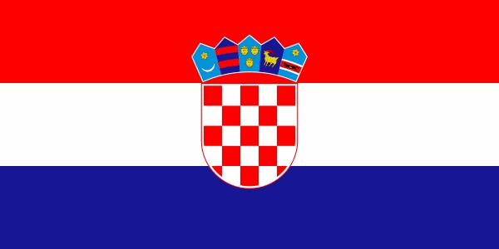
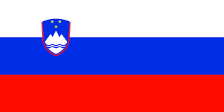
Croatia & Slovenia
In 1991 Croatia declared independence and in 2000 became a World Trade Organization (WTO) member. This country signed a Stabilization and Association Agreement (SAA) with the European Union in 2001. Later in 2009 Croatia became a member of NATO and following this they joined the European Union on 1 July 2013.
In June 1991, after the introduction of multi-party representative democracy, Slovenia split from Yugoslavia and became an independent country. In 2004, it entered NATO and the European Union, then in 2007 became the first formerly communist country to join the Eurozone and in 2010 joined OECD, a global association of high-income developed countries

Slide 15
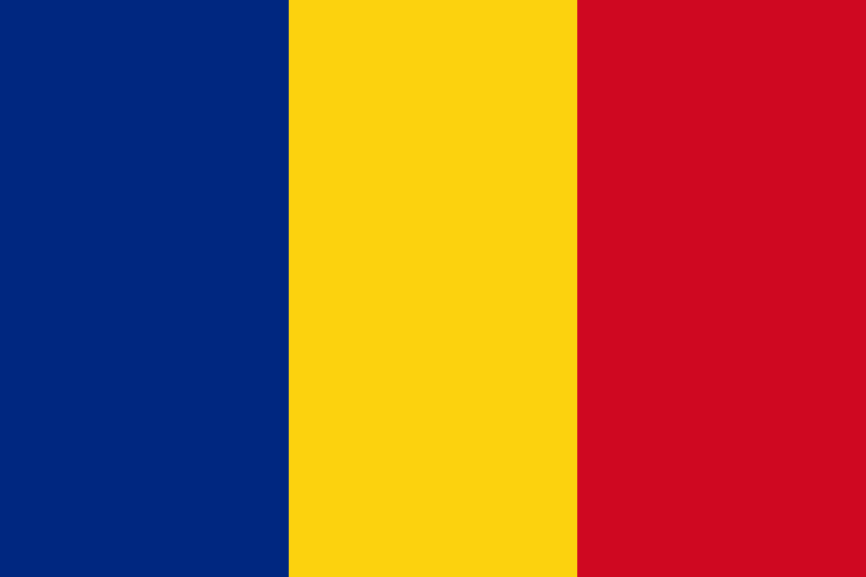
Romania
Romania remained neutral for the first two years of World War I. It joined the Entente Powers and declared war on 27 August 1916
The interwar period is referred as Greater Romania, as the country achieved its greatest territorial extent at that time (almost 300,000 km2 or 120,000 sq mi)
During World War II, Romania was an ally of Nazi Germany against the Soviet Union, fighting side by side with the Wehrmacht until 1944, when it joined the Allied powers and faced occupation by the Red Army forces.
Following the war, Romania became a socialist republic and member of the Warsaw Pact
After the 1989 Revolution, Romania began a transition towards democracy and a capitalist market economy. It joined NATO in 2004 and European Union in 2007

Slide 16
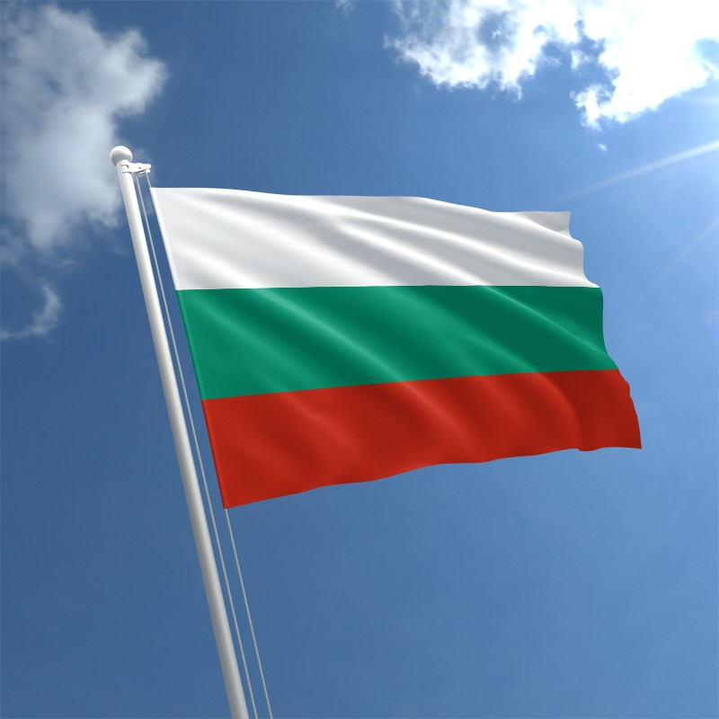
Bulgaria
The beginning of the 20th century saw several conflicts with its neighbours, which prompted Bulgaria to support Germany in both world wars
In 1946 it became a one-party socialist state as part of the Soviet-led Eastern Bloc
In December 1989 the Communist Party allowed multi-party elections, which led to Bulgaria's transition into a democracy and a market-based economy
It became a member of NATO in 2004 and participated in the War in Afghanistan. After few years of reforms it joined the European Union in 2007 despite continued concerns about government corruption

Slide 17
Bibliography
http://archiv.radio.cz/history/history00.html
http://www.mzv.cz/tripoli/en/general_information_about_the_czech/history/index.html
http://www.localhistories.org/czech.html
http://www.localhistories.org/slovakia.html
http://gotohungary.com/history
http://www.bbc.com/news/world-europe-17383522
https://www.britannica.com/place/Baltic-states/Independence-and-the-20th-century
http://web.mit.edu/fjk/www/editor/essays/baltics.html
http://www.bbc.co.uk/history/worldwars/wwone/yugoslavia_01.shtml
http://www.localhistories.org/croatia.html
http://www.bbc.com/news/world-europe-17217954
https://www.slovenia.info/en/plan-your-trip/facts-about-slovenia/history-and-culture
http://www.localhistories.org/rumania.html
http://news.bbc.co.uk/2/hi/europe/country_profiles/1061402.stm
http://www.intopoland.com/poland-info/history-of-poland.html

Slide 18
Thank you for your attention!!! Jakub Wróblewski & Jakub Cyrych

